Slide 1


CNPC Niger Petroleum S.A.
Practical Soft Skills
CNPC Niger Petroleum S.A. CNPC Global Solutions Co. Ltd

Slide 2

Training Agenda
Before we start :
Lecture 1 : Practical Soft Skills

Slide 3

Let’s Know Each Other
Name:
Occupation / Department /title :
Years of experience / Where ?:
Your Expectation:

Slide 4

Training Objectives
After finalizing this training you should be able to
Workplace Etiquette: Demonstrate professional conduct in physical and virtual settings.
Communication: Practice active listening and communicate ideas clearly.
Professional Ethics: Understand the importance of integrity, confidentiality, and accountability.
Time Management: Prioritize tasks effectively and plan their workday.
Problem Solving: Apply a structured approach to identify and solve workplace problems.

Slide 5
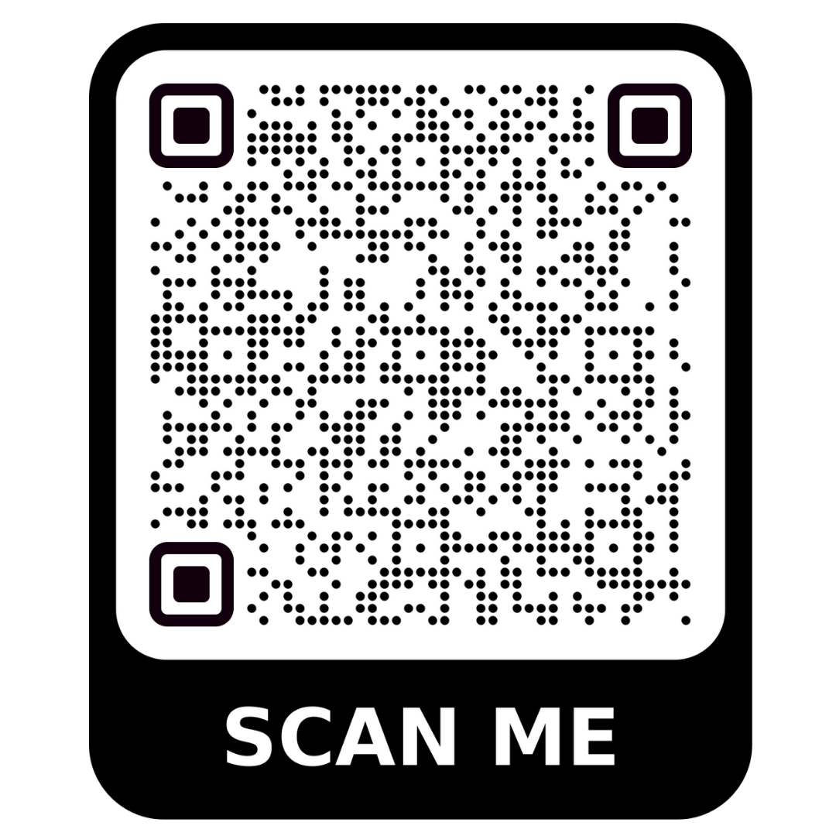
Test your Knowledge
Please scan the QR code here or go to the below website:
https://afathelbab.github.io/cnpc/computer-basics-soft-skills/day1/quiz.html

Slide 6
Quiz Reflection
How many got the full mark?
How got more than 50% correct?
How many got them all wrong?
It’s OK either way

Slide 7
Module 1:
Professional Communication

Slide 8


Module 1: Professional Communication
Active Listening
Active listening means you are fully focused on and engaged with what the other person is saying.
Pay Attention: Put your phone away. Make eye contact. Avoid side-conversations (in person or in chat).
Show You're Listening: Nod, use small verbal cues like "I see" or "uh-huh."
Paraphrase and Confirm: To ensure you understand, repeat their main point back to them.
  Example: "So, if I'm understanding correctly, you need the report by 3 PM, and you want it to focus only on the sales data from last quarter?“
Ask Clarifying Questions: "When you say 'ASAP,' what is the exact deadline you have in mind?"

Slide 9

Module 1: Professional Communication
Effective Communication
Think Before You Speak (or Type): What is the one main point you need to get across?
Be Concise: Avoid rambling. Get to the point quickly and professionally.
Avoid Jargon: Don't use company acronyms or technical terms unless you are sure the other person understands them.
Mind Your Tone: In emails and chats, your tone isn't obvious. Use professional language, and avoid all-caps (which sounds like SHOUTING!).

Slide 10
Module 2:
Workplace Etiquette

Slide 11


Module 2: Workplace Etiquette
In the Physical Office
Punctuality: Be on time for work and for any in-person meetings.
Shared Spaces: Keep common areas (breakroom, kitchen, meeting rooms) clean. If you make a mess, clean it up.
Noise Level: Be mindful of your voice volume, especially in open-plan offices. Take personal calls in a private area.
Dress Code: Follow the company's dress code policy.

Slide 12

Module 2: Workplace Etiquette
In the Virtual Workplace (Teams, Zoom, etc.)
Be on Time: Punctuality is just as important in virtual meetings.
Mute Yourself: Always mute your microphone when you are not speaking to avoid background noise.
Camera On (If It's the Norm): Check with your manager, but many teams prefer cameras on to improve engagement.
Be Aware of Your Background: Make sure your background is clean and work-appropriate. Use a virtual background if needed.
Use the "Raise Hand" Feature: In larger meetings, use the "Raise Hand" button instead of interrupting.

Slide 13
Module 3:
Professional Ethics

Slide 14


Module 3: Professional Ethics
What is Professional Ethics?
Ethics are the moral principles that guide your behavior at work.
Integrity: Doing the right thing, even when no one is watching. This means being honest in your work, your timesheets, and your communications.
Confidentiality: This is critical. You will have access to information that is not public.
                Do Not Share: Client lists, financial data, product plans, or personal employee information (like salaries).
                Action: If you see a document marked "Confidential" left on a printer, secure it and return it to the owner or report it to your manager.

Slide 15


Module 3: Professional Ethics
What is Professional Ethics?
Ethics are the moral principles that guide your behavior at work.
Accountability: Taking ownership of your responsibilities.
  If you make a mistake, don't hide it or blame someone else.
  Report the mistake to your manager, and be part of the solution. This builds trust.
Respect: Treat all colleagues, managers, and clients with respect and professionalism, regardless of their role, background, or opinions.

Slide 16
Module 4:
Time Management & Productivity

Slide 17
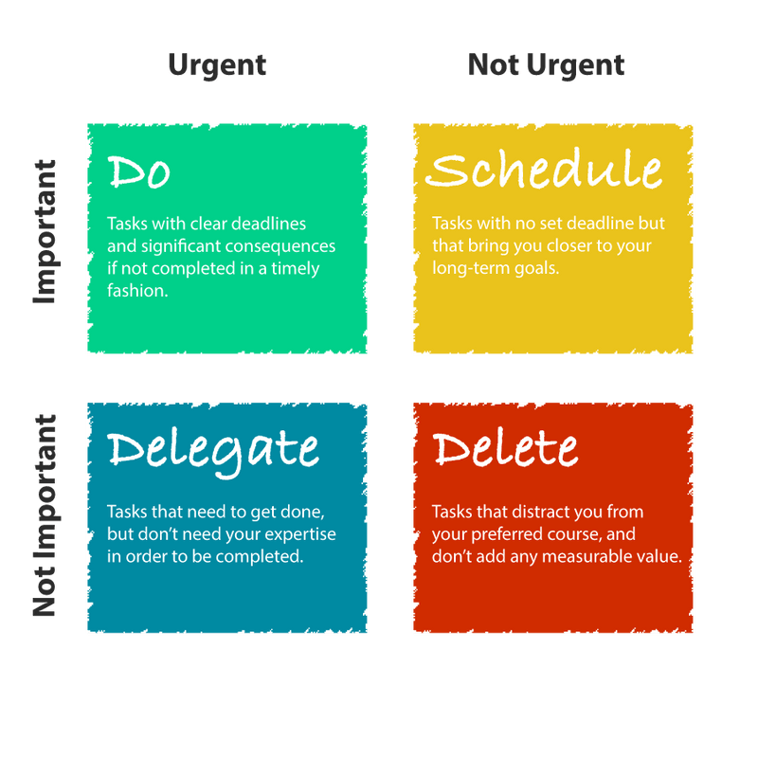
Module 4: Time Management & Productivity
Prioritization: The Eisenhower Matrix
You can't do everything at once.
You must prioritize.
A simple method is the Eisenhower Matrix, which divides tasks into four categories:

Slide 18
Module 4: Time Management & Productivity
Prioritization: The Eisenhower Matrix
Quadrant 1: Urgent & Important (DO):
Crises, deadlines, immediate problems. Do these first.
Quadrant 2: Not Urgent & Important (SCHEDULE):
Long-term planning, relationship building, professional development. This is where you should spend most of your time. Schedule it on your calendar.
Quadrant 3: Urgent & Not Important (DELEGATE):
Interruptions, some emails, certain meetings. These feel urgent but don't help you reach your goals. Can you delegate or politely decline?
Quadrant 4: Not Urgent & Not Important (DELETE):
Trivial tasks, time-wasters. Avoid or delete these.

Slide 19

Module 4: Time Management & Productivity
Planning Your Day
Don't just react to emails. Start your day with a plan.
Make a To-Do List: At the end of each day (or first thing in the morning), write down the 3-5 most important things you need to accomplish.
Time Blocking: Open your Outlook Calendar and block off time for your important tasks (from Quadrant 2).
9:00 - 10:00: Review and respond to urgent emails.
    10:00 - 11:30: "Focus Time: Draft Project X Report“
    11:30 - 12:00: Check emails again.
Protect Your Focus: Turn off email and chat notifications during your "Focus Time" blocks.

Slide 20

Module 4: Time Management & Productivity
Open Discussion
Which of the four quadrants (Do, Schedule, Delegate, Delete) do you think is the hardest to manage? Why?
Why is it important to "schedule" time for your own important work, not just for meetings?

Slide 21
Module 5:
Problem Solving

Slide 22

Module 5: Problem Solving
A Structured Approach to Problem Solving
Problems will come up. It's a normal part of work.
The key isn't to avoid problems, but to have a clear method for solving them effectively.
Here is a simple 4-step approach you can apply to almost any workplace problem.
1. Define the Real Problem
2. Brainstorm Potential Solutions
3. Evaluate and Choose a Solution
4. Implement and Review

Slide 23

Module 5: Problem Solving
Define the Real Problem
Don't just fix the symptom; find the root cause.
Symptom: "A critical pump (P-101) is down, stopping production.“
Real Problem: "The scheduled preventive maintenance (PM) wasn't done.“

Slide 24
Module 5: Problem Solving
Define the Real Problem
Root Cause (Keep asking "Why?"):
1. Why was the PM not done?
"The maintenance team didn't have the filter replacement part."
2. Why?
"The part wasn't ordered."
3. Why?
"The inventory system said we had 2 in stock, but the shelf was empty."
4. Why?
"The last part was used for an emergency repair on P-102, and the inventory wasn't updated."
5. Why?
"The technician who took the part was covering a night shift and forgot to log the removal in the system."
  Root Cause: "Our process for removing inventory on off-hours is not being followed."

Slide 25

Module 5: Problem Solving
Brainstorm Potential Solutions
Now that you know the root cause, what are some ways to fix it?
Don't judge ideas at this stage. Write everything down.
Example (for the root cause above):
  Implement a barcode scanner at the warehouse door (Must scan part and badge).
  Do a full re-training session on the inventory procedure.
  Put a physical, mandatory sign-out sheet on the warehouse shelf for "after-hours" use.
  Lock the parts warehouse after 5 PM; all parts must be requested from a supervisor.

Slide 26
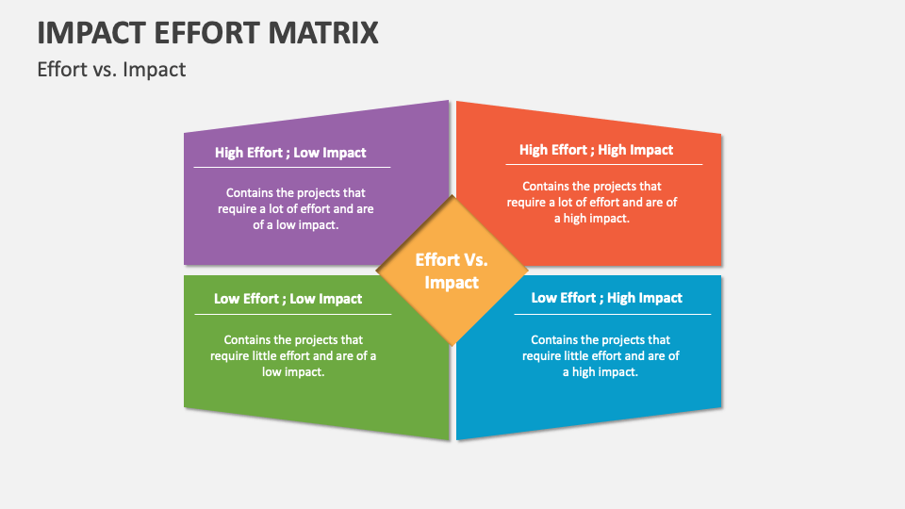
Module 5: Problem Solving
Evaluate and Choose a Solution
Look at your list of solutions and pick the best one(s).
A simple "Effort vs. Impact" matrix is a great tool
 | Low Impact | High Impact
High Effort | Thankless Tasks (Avoid these) | Fill-ins (Do if you have time)
Low Effort | Major Projects (Plan these) | Quick Wins! (Do these first)

Slide 27

Module 5: Problem Solving
Evaluate and Choose a Solution
Analysis:
Barcode scanner:
(High Effort, High Impact) -> Major Project.
Re-training:
(Medium Effort, Medium Impact)
Physical sign-out sheet:
(Low Effort, High Impact) -> Quick Win!
Lock warehouse:
(High Effort, Low Impact) -> Thankless Task (causes other problems).

Slide 28
Module 5: Problem Solving
Evaluate and Choose a Solution
Decision:
Let's
Add the physical sign-out sheet immediately (Quick Win)
and
schedule the barcode scanner as a long-term project.

Slide 29

Module 5: Problem Solving
Implement and Review
Put your chosen solution into action. But you're not done yet.
Implement: The warehouse manager creates and places the sign-out sheet. An email is sent to all supervisors about the new temporary rule.
Review: Check back in a month. Run an inventory report. "Have our 'system vs. actual' inventory counts improved?" If yes, it worked. If no, it didn't. This step is critical.
This structured process helps you avoid panic and find a solution that lasts.

Slide 30
Module 5: Problem Solving
Open Discussion
Why is it so important to correctly define the problem (Step 1) before trying to brainstorm solutions (Step 2)?
Think of a simple, common problem (e.g., "We keep running out of printer paper in the breakroom"). How would you apply these 4 steps?

Slide 31
Test your Knowledge
Again!
Please scan the QR code here or go to the below website:
https://afathelbab.github.io/cnpc/computer-basics-soft-skills/day1/quiz.html

Slide 32



A Better You, A Better Niger
74

Slide 33
Backup Slides

Slide 34
Workshop

Slide 35
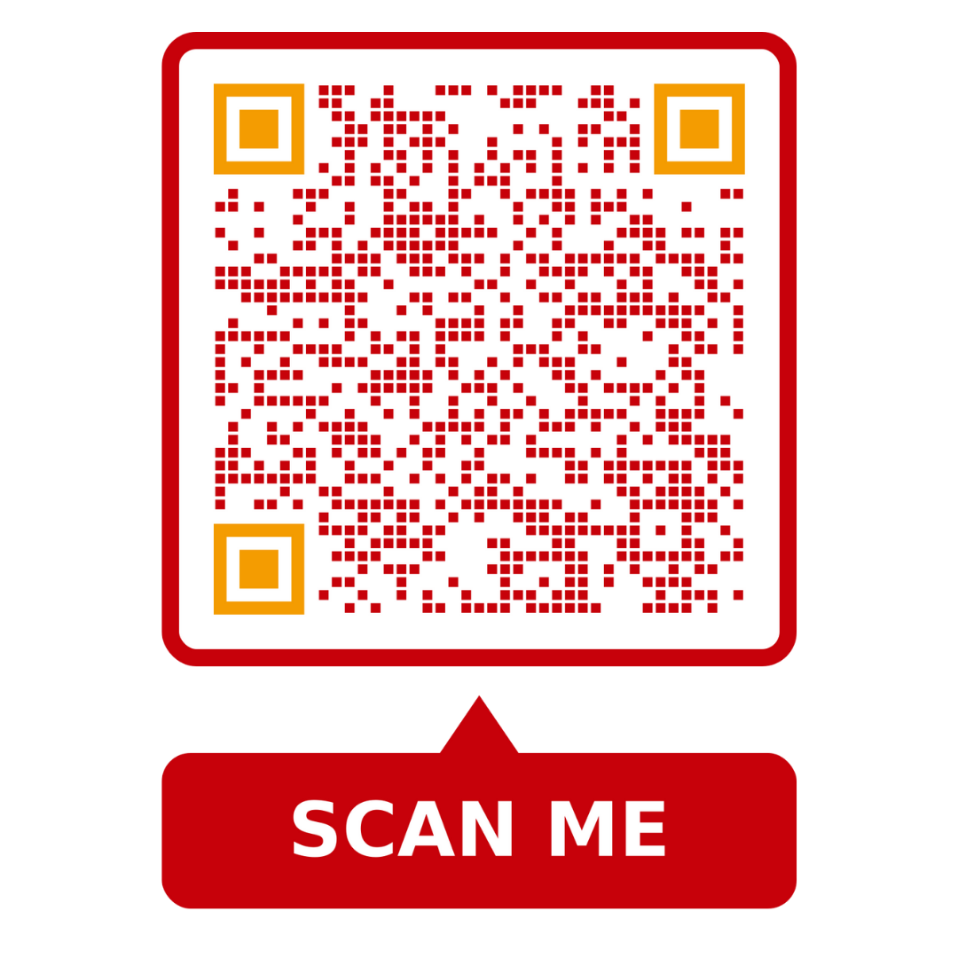

Workshop
https://afathelbab.github.io/cnpc/computer-basics-soft-skills/workshops/

